Slide 1
VISION Assistive Caption Bot For Visually IMPAIRED
Presented
by
Saranya Priya Jeyaraman

Slide 2
ABSTRACT
Automatic Caption Generation is an important and challenging research area in the field of computer vision and natural language processing. Generating captions and captions to speech has various practical benefits, ranging from helping visually impaired to self driving car. The project goal is to create a caption bot based on the model CNN-LSTM neural networks which detects the objects in the images automatically and generate meaningful descriptions for the images. CNN helps detect the objects in the image and LSTM is to caption the images. Using Google Text To Speech (GTTS) API, captions are converted to speech. Finally, the code is deployed as a REST API using FLASK which is a web development framework of python and created UI. The main use case of this project is to help visually impaired to understand the surrounding environment and act according to that.

Slide 3
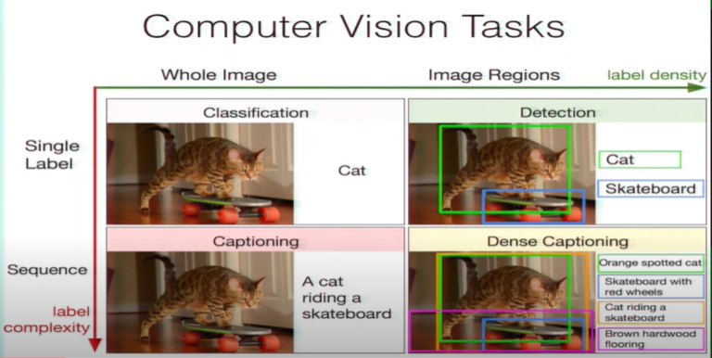

Slide 4
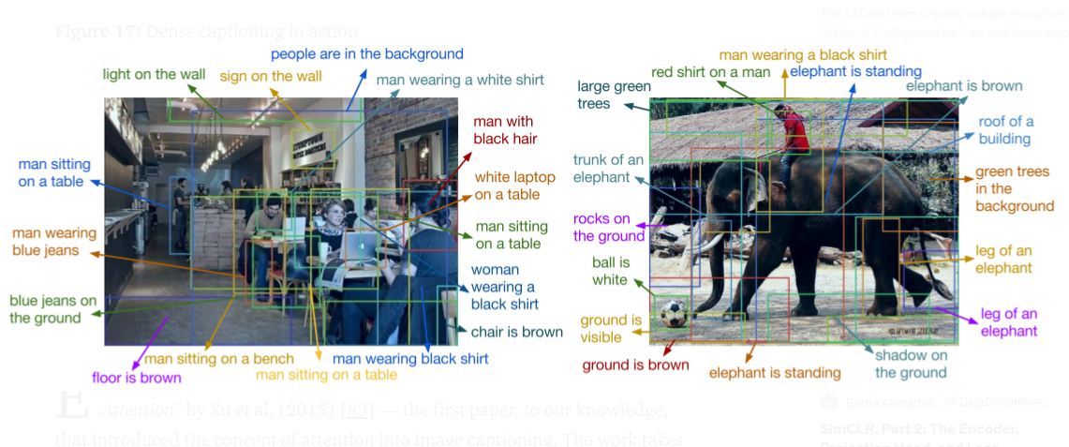
DENSE CAPTIONING

Slide 5
SYSTEM REQUIREMENTS
Hardware Requirements Recommendation:
RAM: 4 GB (minimum)
Hard disk: 500 GB
Software Requirements Recommendation:
Operating System : Windows (above 7 64-bit), Linux and MAC
Web Interface : Flask Rest API ( Python Web Framework)
Programming Language: Python
Libraries : Tensorflow, Keras, Numpy, Matplotlib , Flask-python,
Browser: Chrome , Firefox

Slide 6
Reference Research Papers and related work:
Deep Visual-Semantic Alignments for Generating Image Descriptions Sentences act as weak labels : contiguous sequences of words correspond to some particular (unknown) location in image.
Adaptive Attention via A Visual Sentinel for Image Captioning. Predicting the non-visual information like “the”, “and” etc.. while generating meaningful caption.
Deep Captioning with Multimodal Recurrent Nets. Very complex and time taking strategy, which is very difficult and costlier to deploy in real world.

Slide 7
DATASETS
Flickr8k (used for this project)
8091 images, each accompanied with 5 descriptions
6000 for training the model, 2000 for validation and testing
Flickr30k
30k images
MSCOCO
123,000 images
5000 for validation, testing

Slide 8
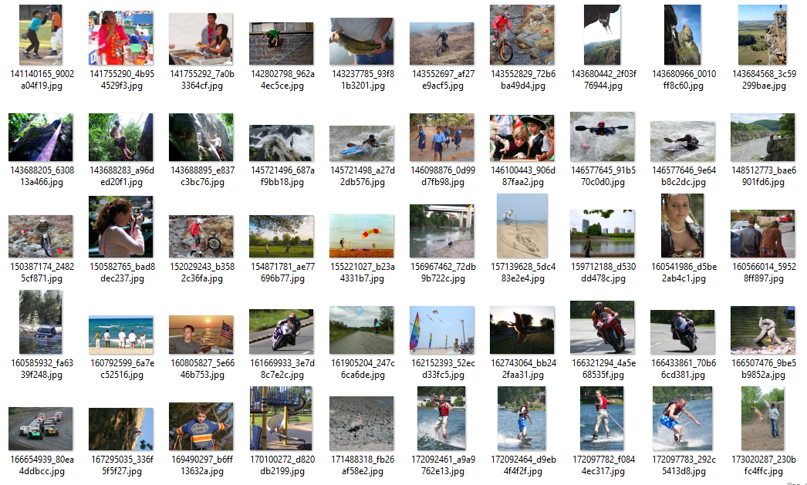

Slide 9
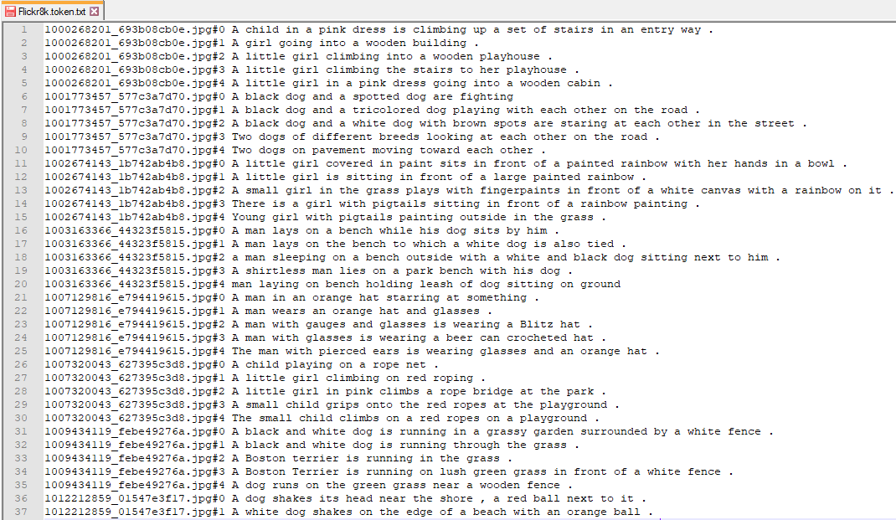

Slide 10
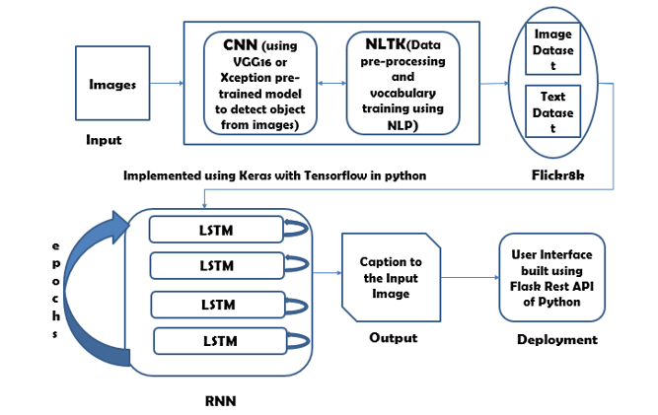
ARCHITECTURE DIAGRAM OF VISION ASSISTIVE CAPTION BOT

Slide 11
Project MODULES
Creating pre-trained model (Transfer Learning)
Object detection
Sentence Generation
Ranking based caption retrieval
Deployment to Web Server

Slide 12
TRANSFER LEARNING
Transfer Learning is one of the most powerful ideas in deep learning, where knowledge acquired from a new network of one model and applying that knowledge on another model on a separate task
With transfer learning, no need to start the learning process from scratch, use the patterns that has been already learnt while solving a different problem.
It helps to build accurate models in a timesaving manner.
Transfer learning mostly used in predictive modelling problems with image/videos as input, they have pre-trained models with huge volume of ImageNet dataset.
It is also used in natural language processing problems that takes text as input. In our project, transfer learning is used in two places, one is during feature extraction and another is during word embeddings.

Slide 13

Convolution Neural Network
CNN stands for CONVOLUTIONAL NEURAL NETWORK.

Slide 14
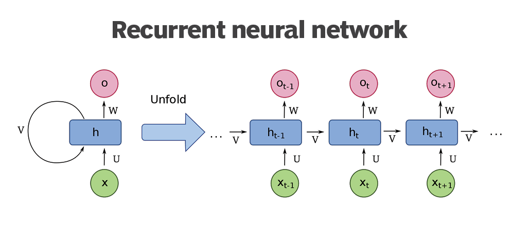
[S_{t}=F(S_{t-1}+W_{t})]

Slide 15
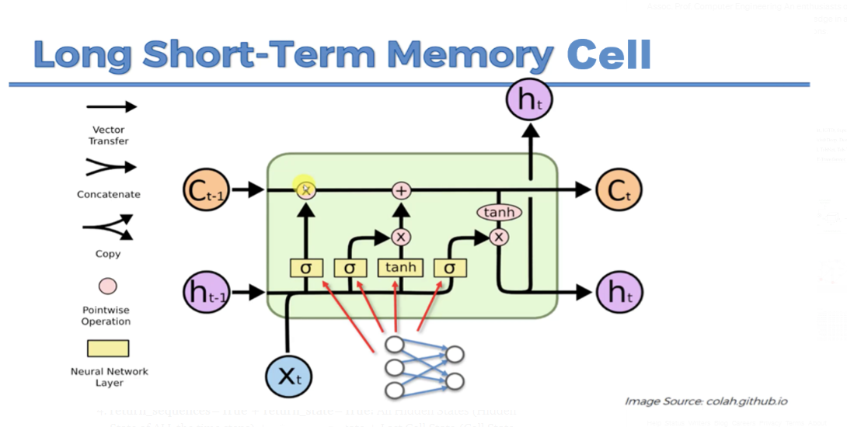

Slide 16
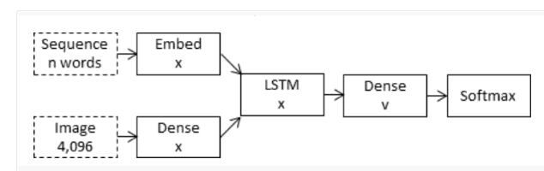
Merge Model Architecture
Photo Feature Extractor
Sequence Processor
Decoder

Slide 17
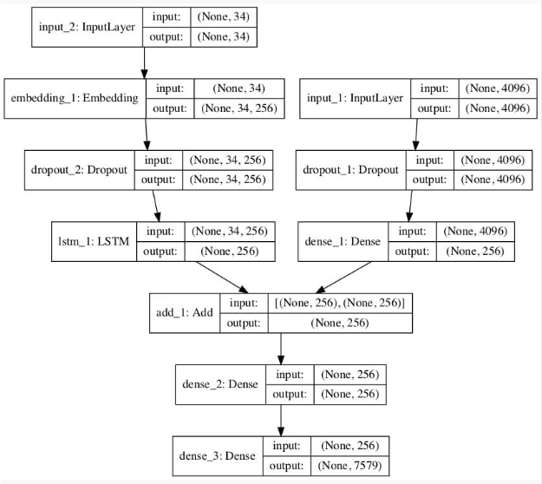
Plot of the Caption Generation Deep Learning Model

Slide 18
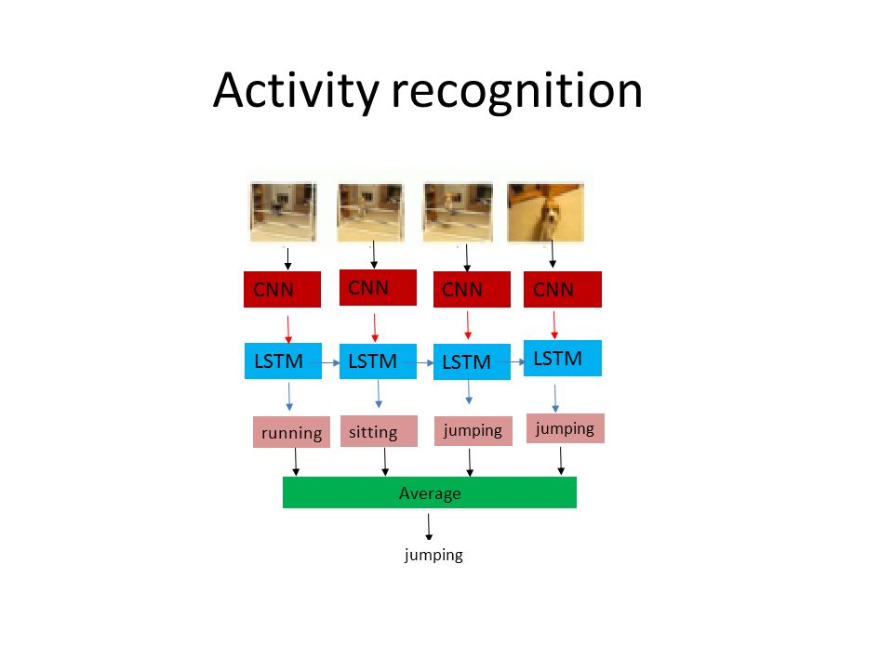

Slide 19
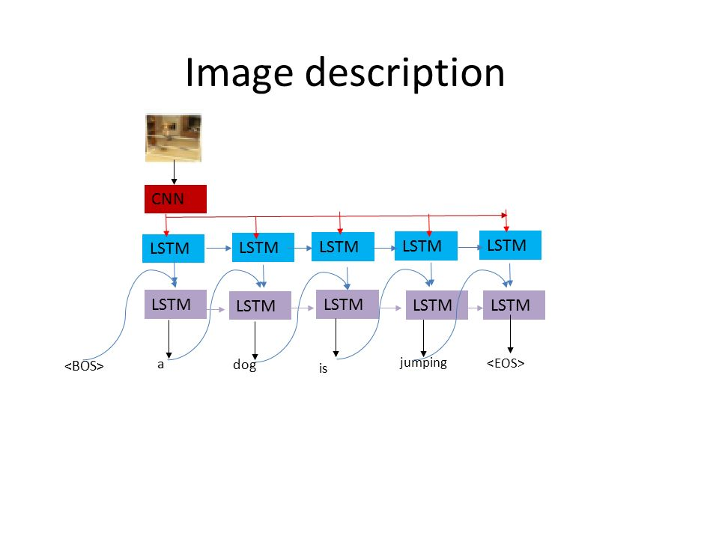

Slide 20
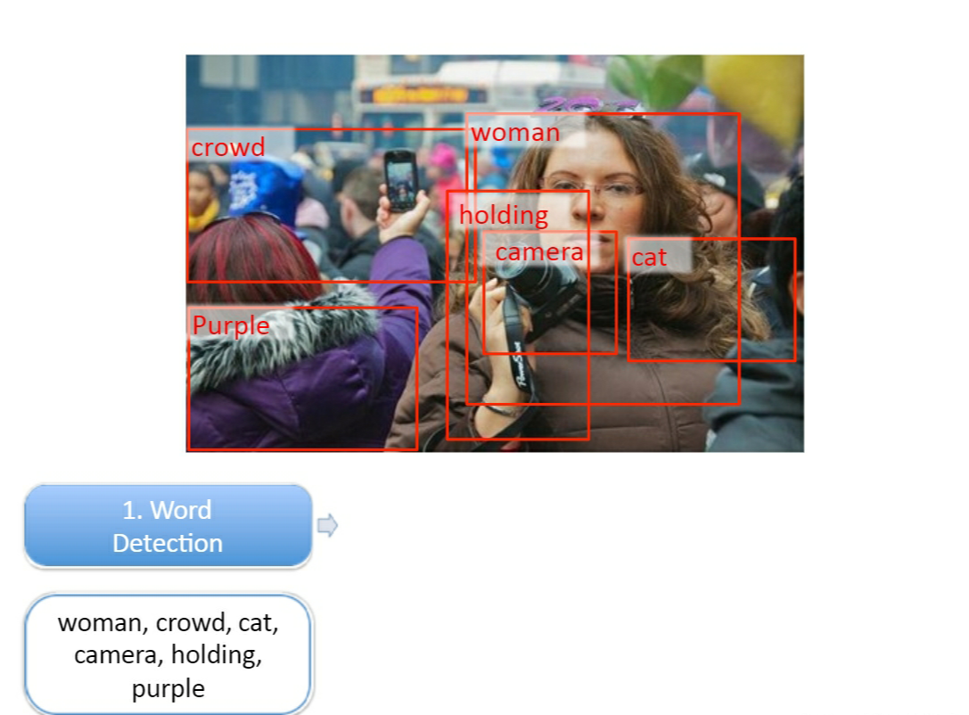
OBJECT DETECTION

Slide 21
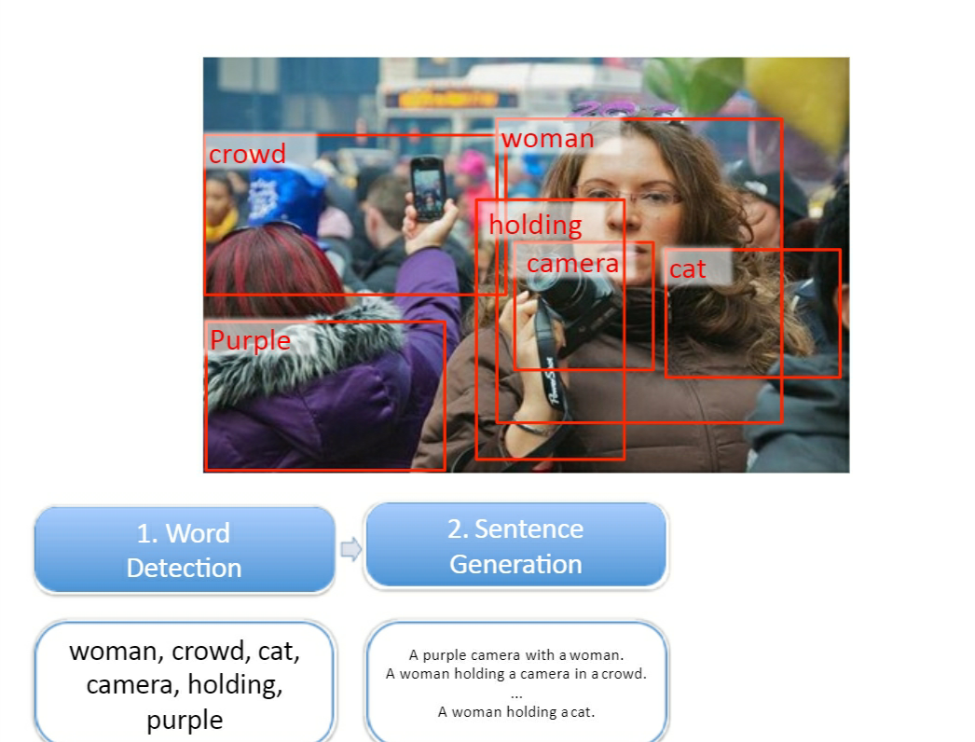
SENTENCE GENERATION

Slide 22
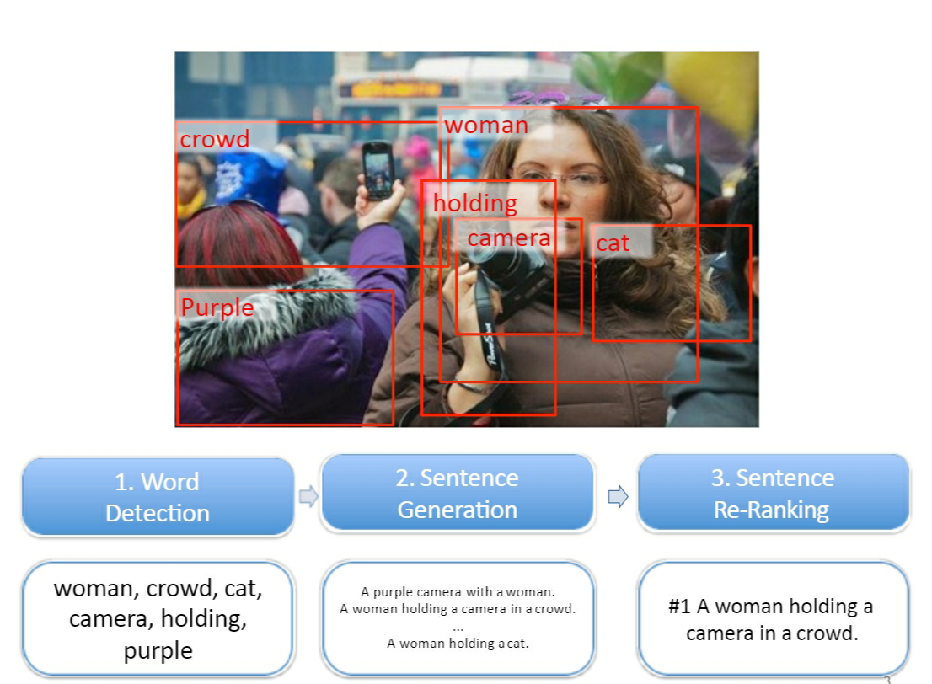
RANKING BASED CAPTION RETRIEVAL

Slide 23
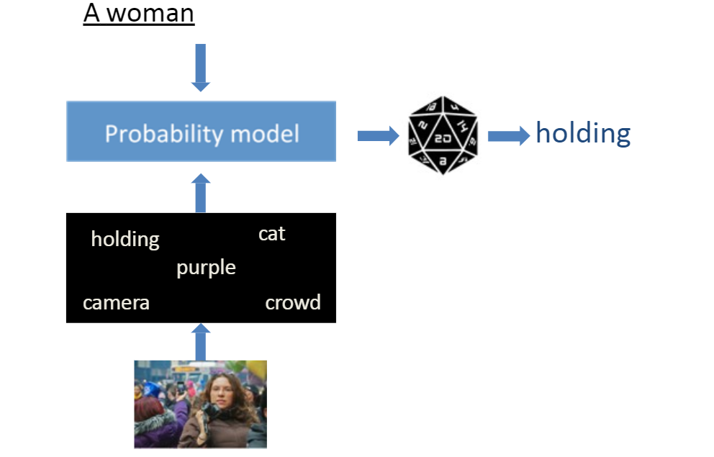
NLP PROBABILISTIC MODEL

Slide 24
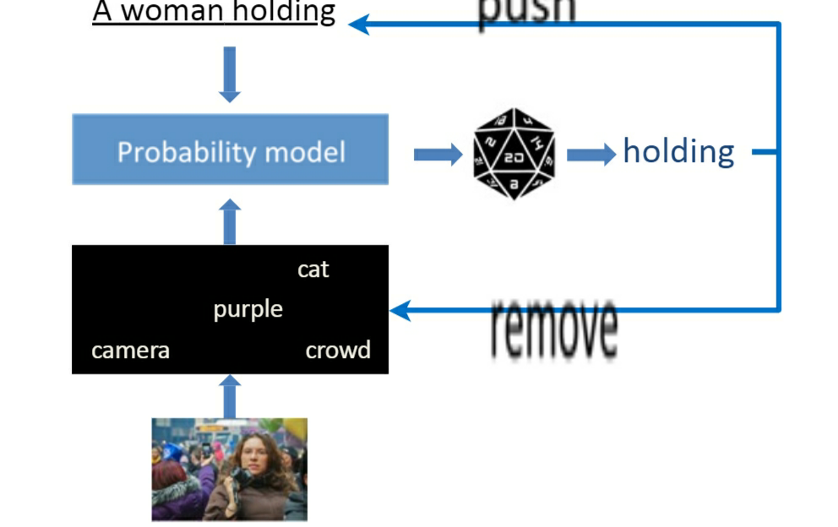
NLP PROBABILISTIC MODEL

Slide 25
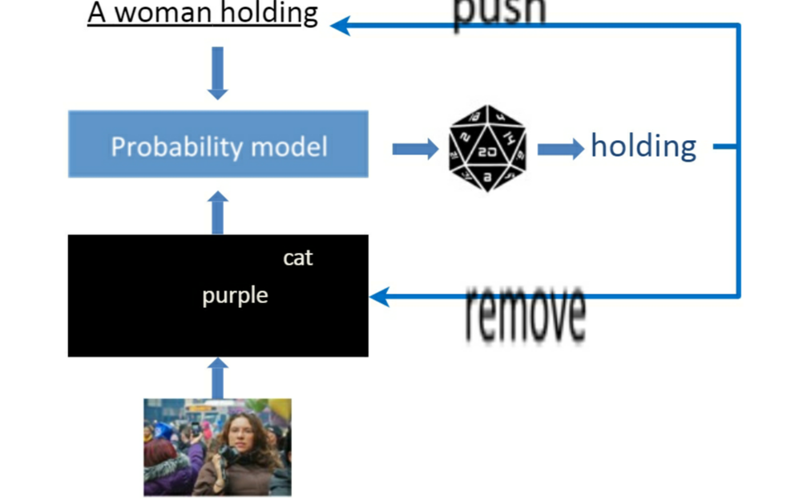
NLP PROBABILISTIC MODEL

Slide 26
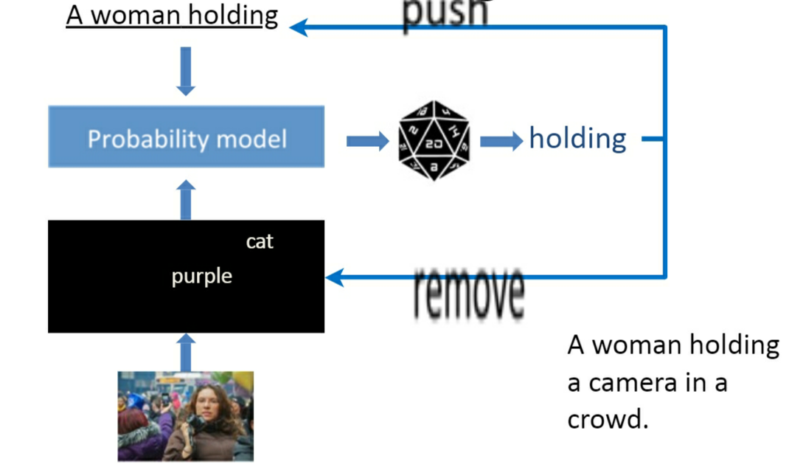
NLP PROBABILISTIC MODEL

Slide 27
PRE TRAINED FILES
Descriptions.txt
Features.pkl
Tokenizer.pkl
Model.h5

Slide 28
LIBRARIES USED
TENSORFLOW
KERAS
PICKLE
NLTK
MATPLOTLIB

Slide 29
DEPLOYING AS A WEB APPLICATION
We have used FLASK to deploy our project as a REST-API in the form of a web application.
FLASK is a web application framework of PYTHON used mostly to deploy machine learning models.

Slide 30
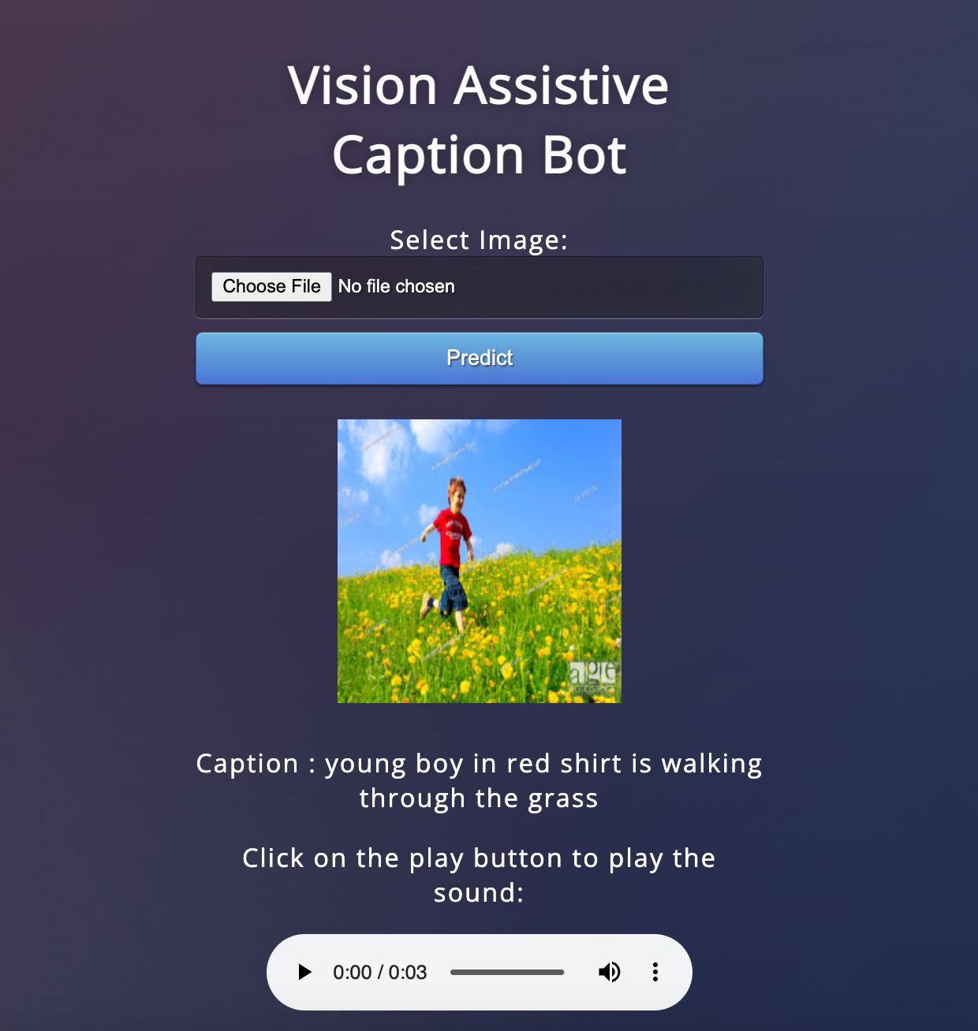

Slide 31
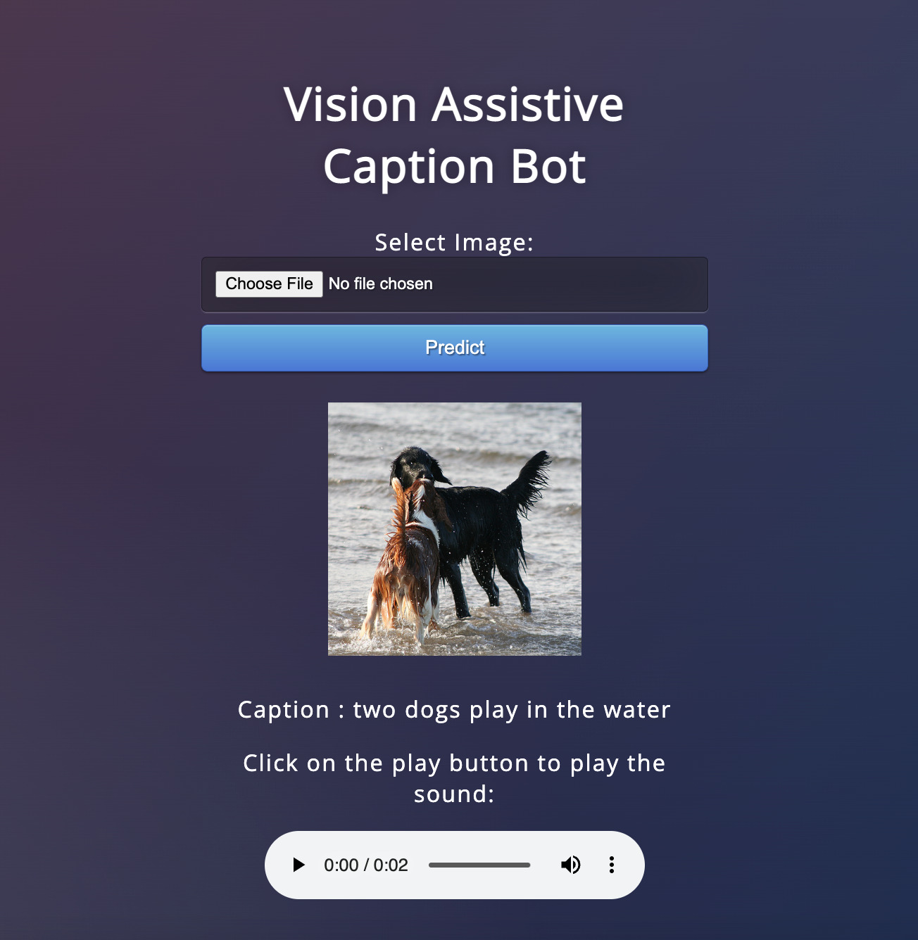

Slide 32
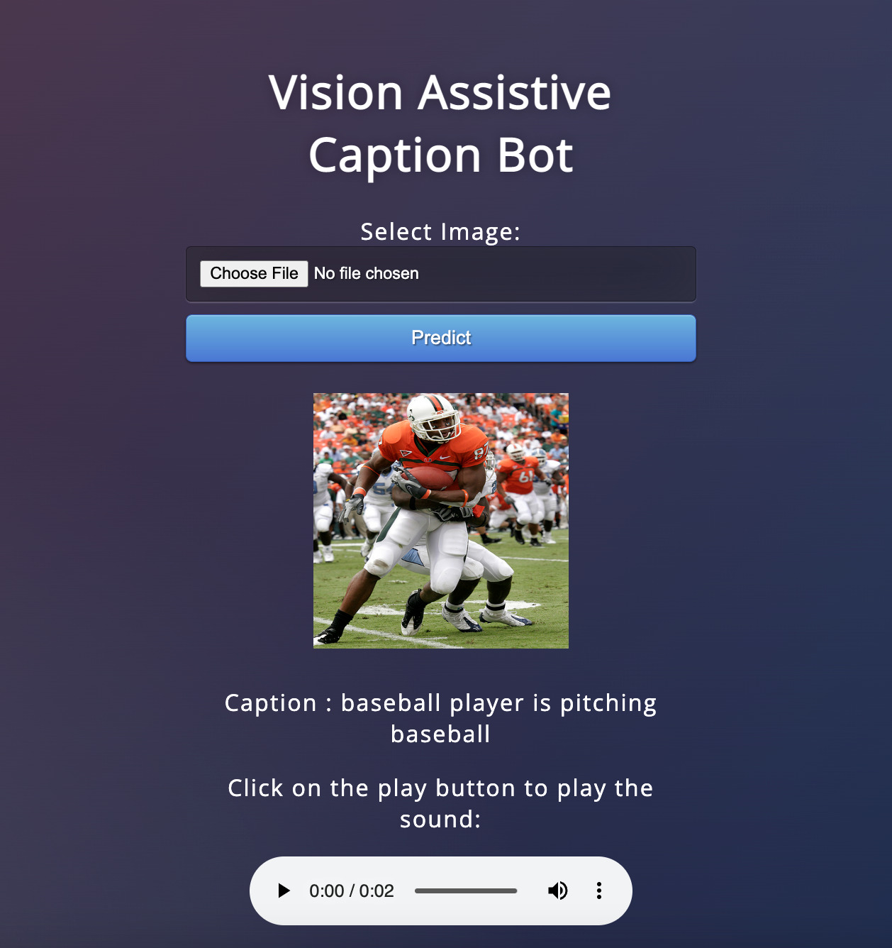

Slide 33
Thank YOU

